Slide 1
Project 2020 Graphics
Posters can be easily modified before printing to hang in the building.
Custom posters are best print on a slightly thick gloss to maximize width.
Your preferred title, theme verse, or graphic style can be completed with quick modifications unless you want to create your own.
These can ONLY be for classroom use as they remain the property of their copyright owner.

Slide 2

2
2
Enlightening
the Eyes
Ephesians 1:18-19
From Darkness to Light
Acts 26:18
Walk by Faith, not by Sight
2 Corinthians 5:7
20
20
2
2
Open My Eyes Psalms 119:18
20
Fixing Our Eyes On Jesus
Hebrews 12:2
20
Acts 26:18 To open their eyes, and to turn them from darkness to light, and from the power of Satan unto God, that they may receive forgiveness of sins, and inheritance among them which are sanctified by faith that is in me.
MARRTOWN ROAD CHURCH OF CHRIST

Slide 3
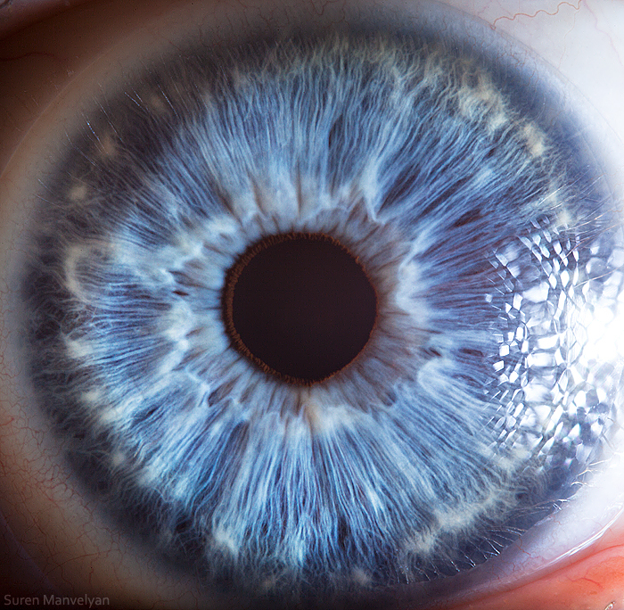



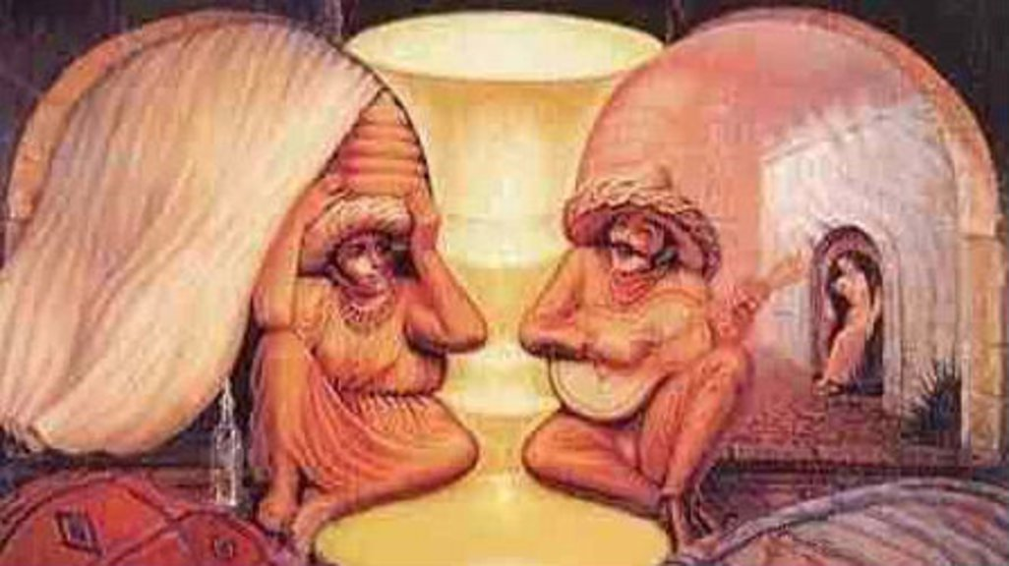
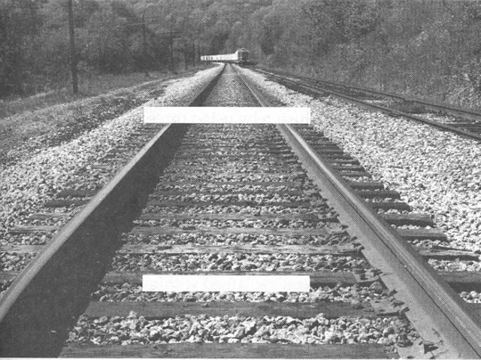
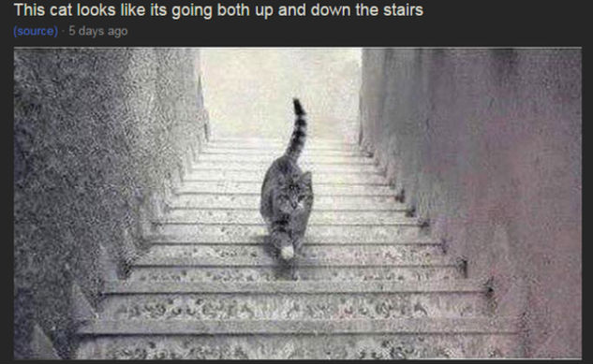
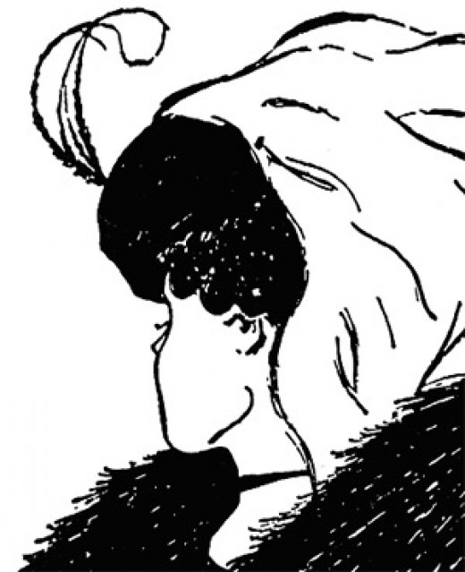
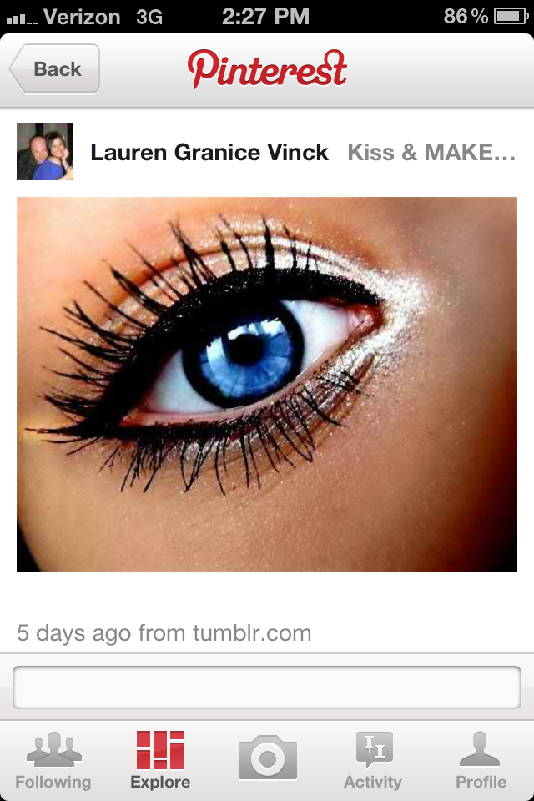
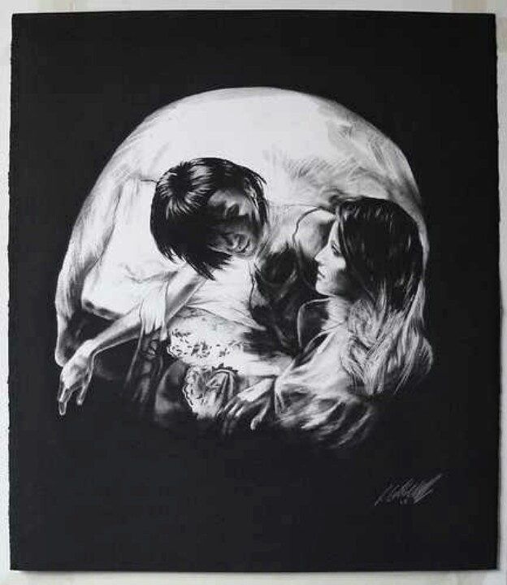

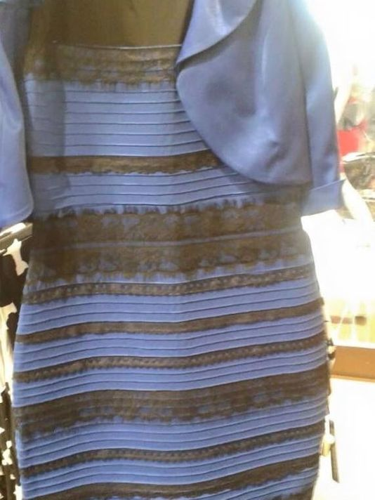
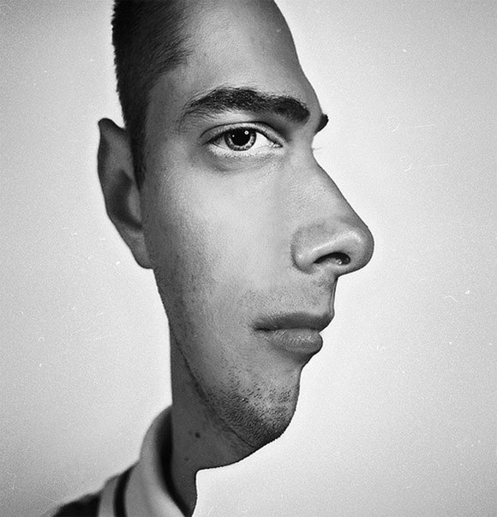
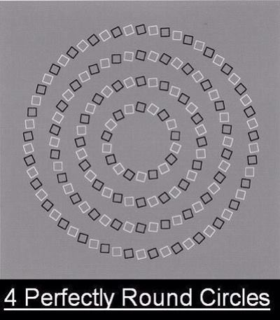
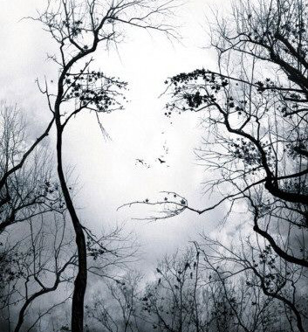


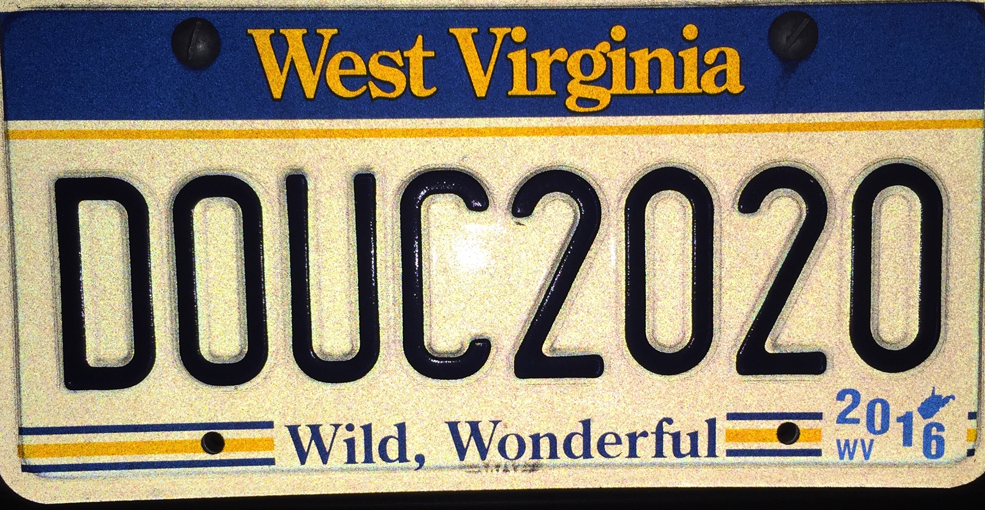
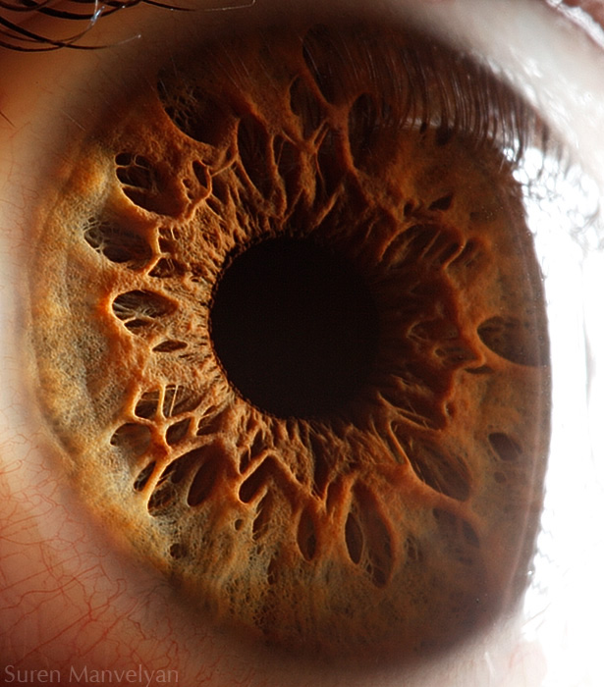
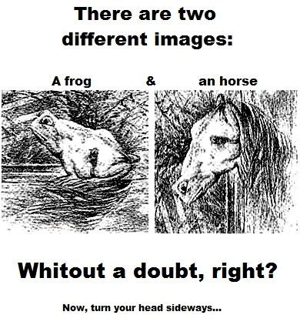
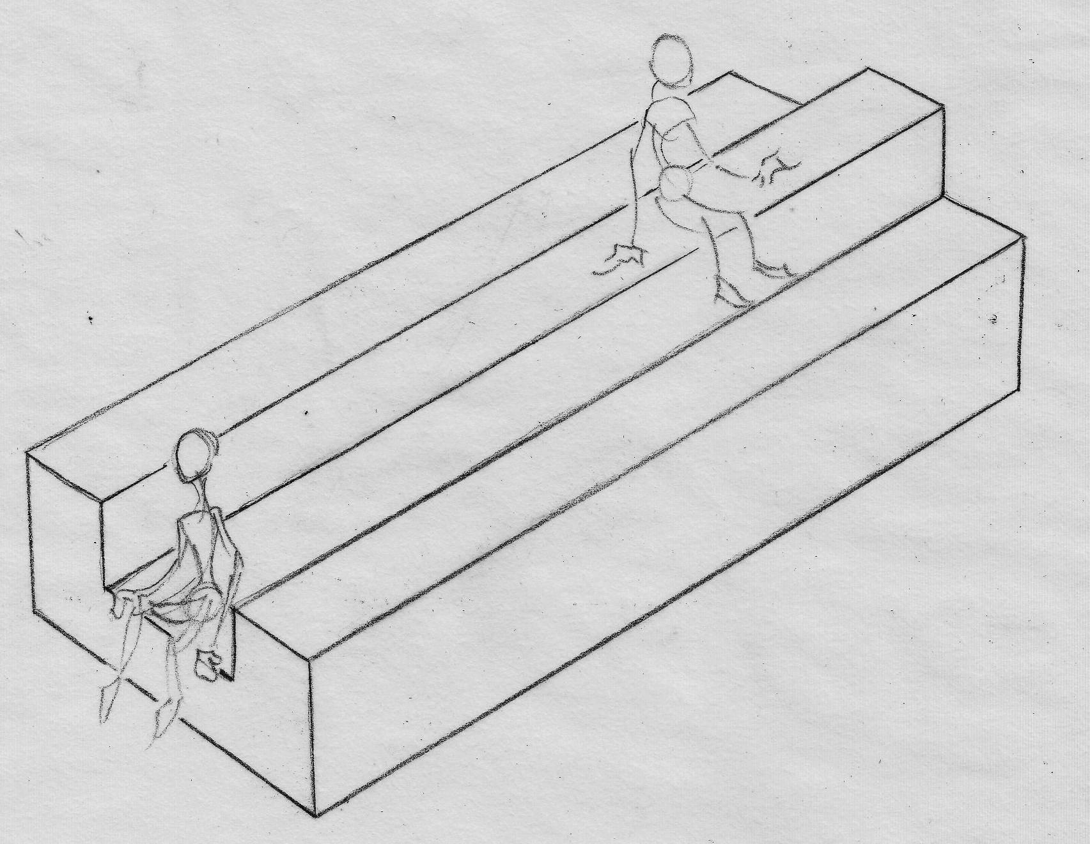
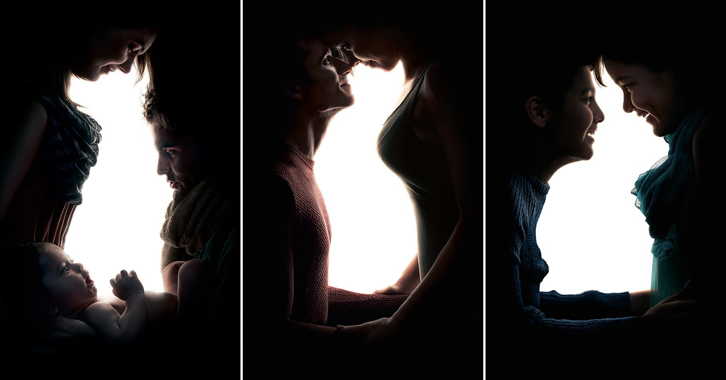
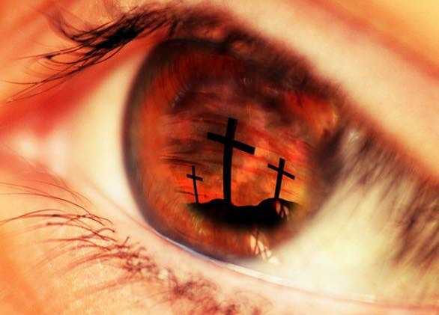
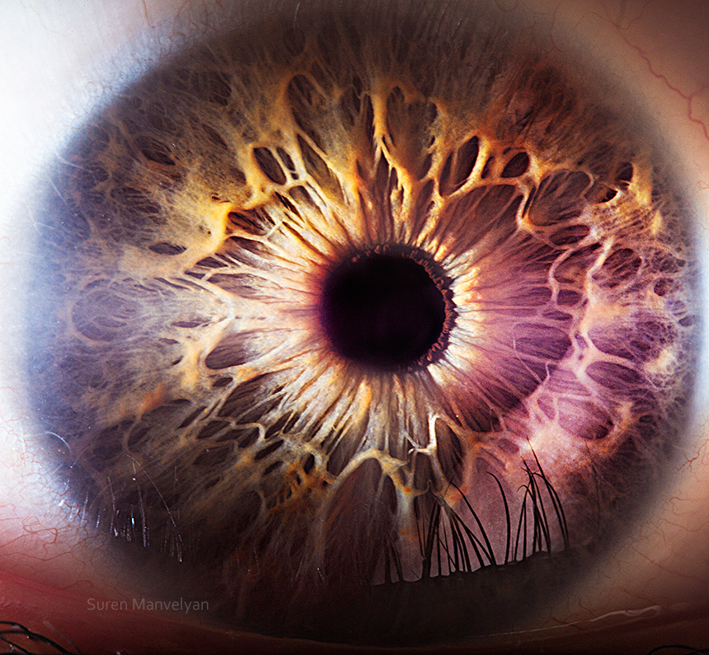
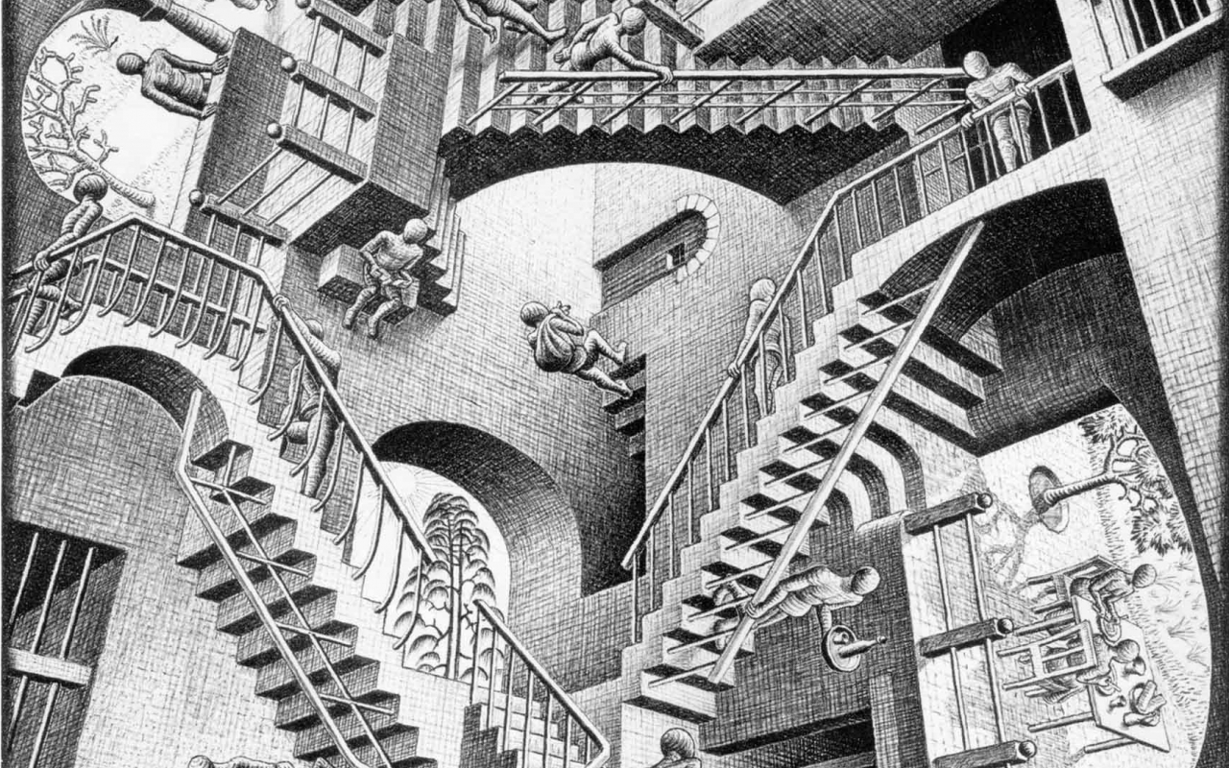
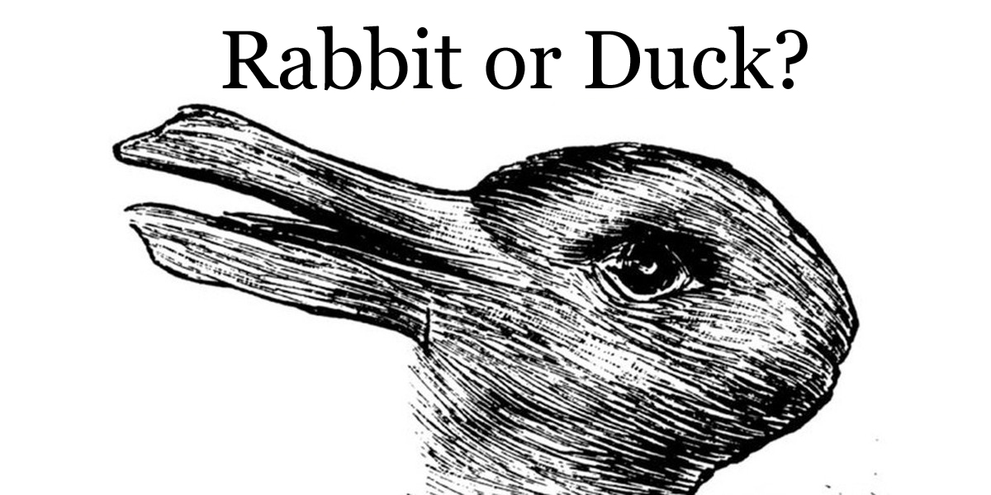
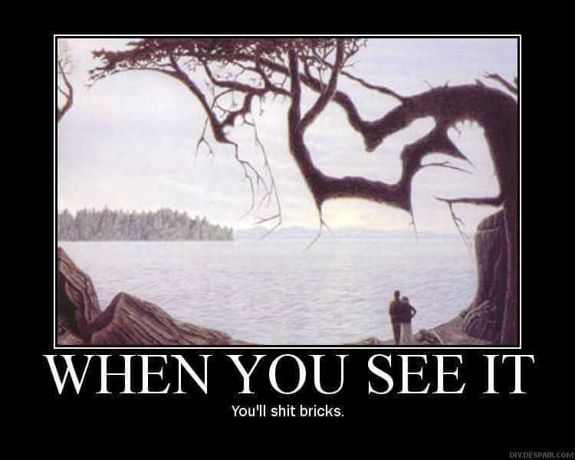
2
Enlightening
The Eyes
Ephesians 1:18-19
2

Slide 4
2
Enlightening
The Eyes
Ephesians 1:18-19
Open My Eyes Psalms 119:18
20

Slide 5

Enlightening The Eyes
Ephesians 1:18-19

Slide 6
Enlightening
The Eyes
Ephesians1:18-19
MARRTOWN ROAD CHURCH OF CHRIST

Slide 7
Enlightening
The Eyes
Ephesians 1:18-19
2
Open My Eyes Psalms 119:18
20
MARRTOWN ROAD CHURCH OF CHRIST

Slide 8
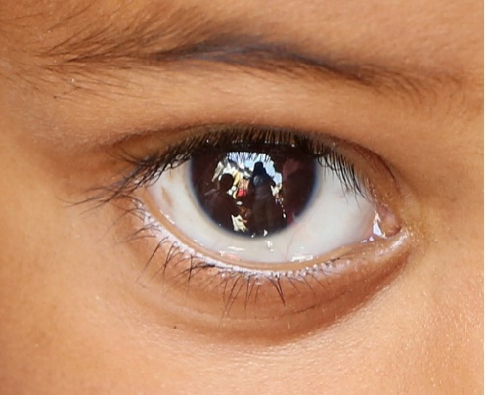



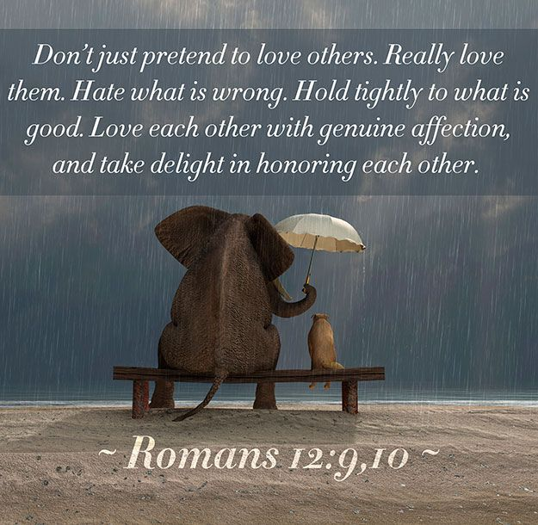



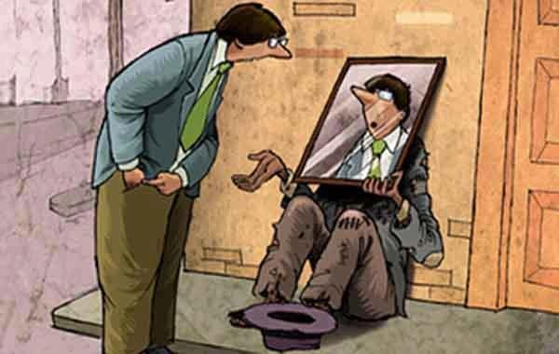
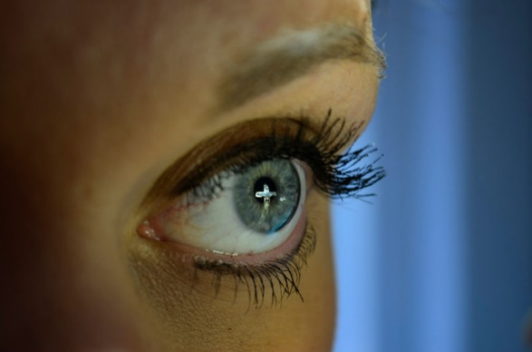

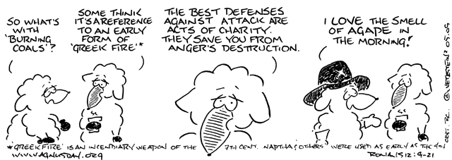
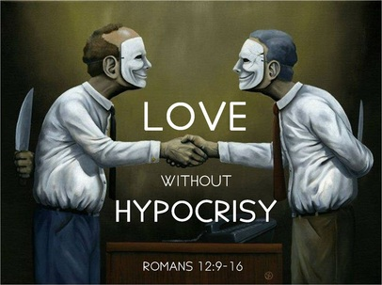

Slide 9
2
From Darkness to Light
Walk by Faith, not by Sight
20
Acts 26:18 To open their eyes, and to turn them from darkness to light, and from the power of Satan unto God,
that they may receive forgiveness of sins, and inheritance among them which are sanctified by faith that is in me.
MARRTOWN ROAD CHURCH OF CHRIST

Slide 10
2
Walk by Faith, not by Sight
20
Enlightening The Eyes
Psalms 19:8
Acts 26:18 To open their eyes, and to turn them from darkness to light, and from the power of Satan unto God,
that they may receive forgiveness of sins, and inheritance among them which are sanctified by faith that is in me.
MARRTOWN ROAD CHURCH OF CHRIST

Slide 11
2
Walk by Faith, not by Sight
20
From Darkness to Light
Acts 26:18 To open their eyes, and to turn them from darkness to light, and from the power of Satan unto God,
that they may receive forgiveness of sins, and inheritance among them which are sanctified by faith that is in me.
MARRTOWN ROAD CHURCH OF CHRIST

Slide 12
2
2
From Darkness to Light
Walk by Faith, not by Sight
20
20
Enlightening
the Eyes
Psalms 19:8
MARRTOWN ROAD CHURCH OF CHRIST

Slide 13
2
Walk by Faith, not by Sight
20
From Darkness to Light
Acts 26:18 To open their eyes, and to turn them from darkness to light, and from the power of Satan unto God,
that they may receive forgiveness of sins, and inheritance among them which are sanctified by faith that is in me.
MARRTOWN ROAD CHURCH OF CHRIST

Slide 14
2
From Darkness to Light
20
Walk By Faith Not By Sight
2 Corinthians 5:7
MARRTOWN ROAD CHURCH OF CHRIST

Slide 15
2
From Darkness to Light
20
Walk By Faith Not By Sight
2 Corinthians 5:7
MARRTOWN ROAD CHURCH OF CHRIST

Slide 16
2
From Darkness to Light
20
Walk By Faith Not By Sight
2 Corinthians 5:7
MARRTOWN ROAD CHURCH OF CHRIST

Slide 17
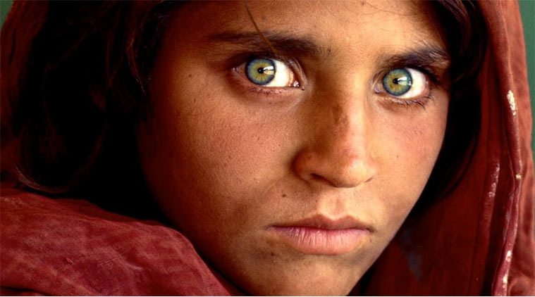
2
Walk By Faith
Not By Sight
From
Darkness
to Light
20
MARRTOWN ROAD CHURCH OF CHRIST

Slide 18
2
From Darkness To Light
Acts 26:18
2

Slide 19
2
Walk By Faith Not By Sight
2 Corinthians 5:7
2

Slide 20


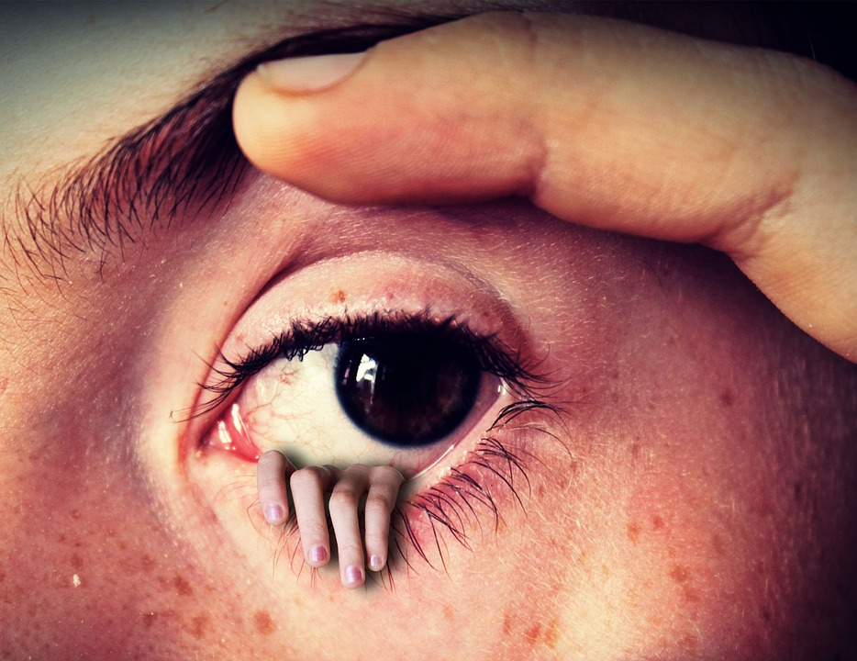







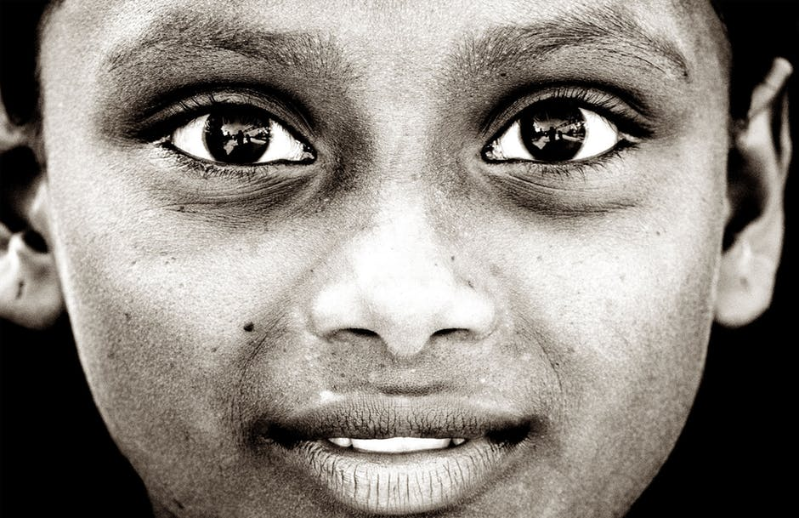


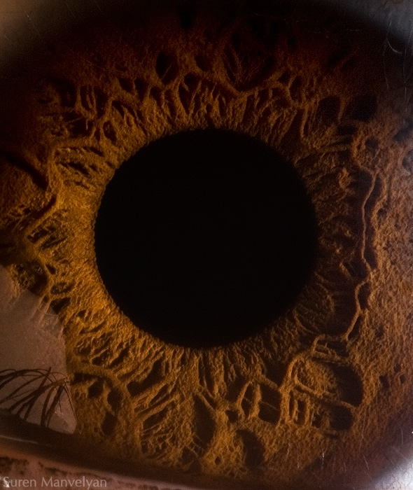

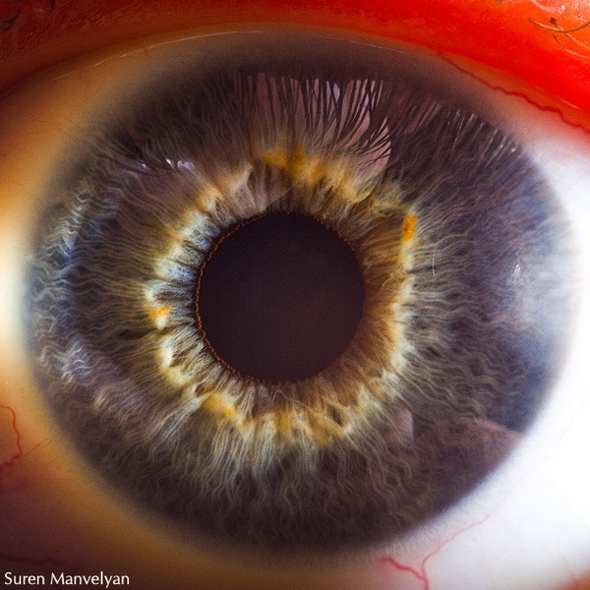


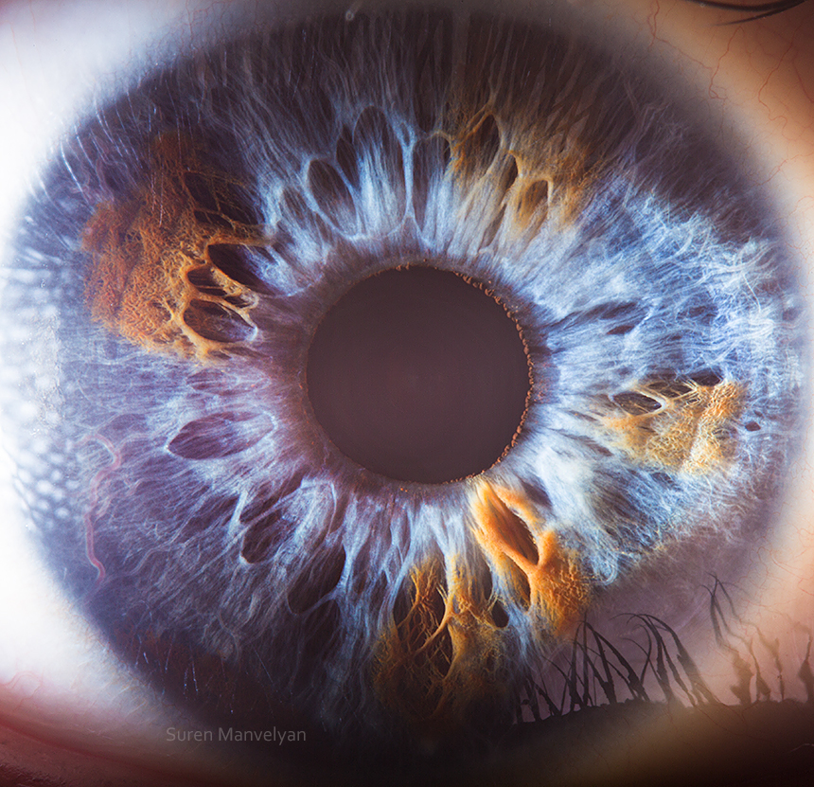
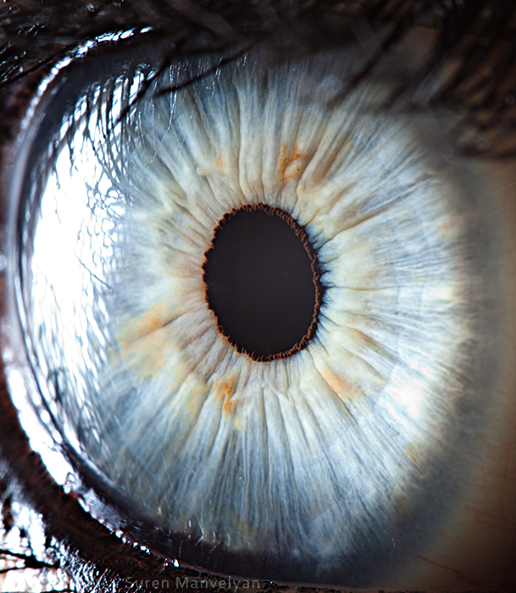
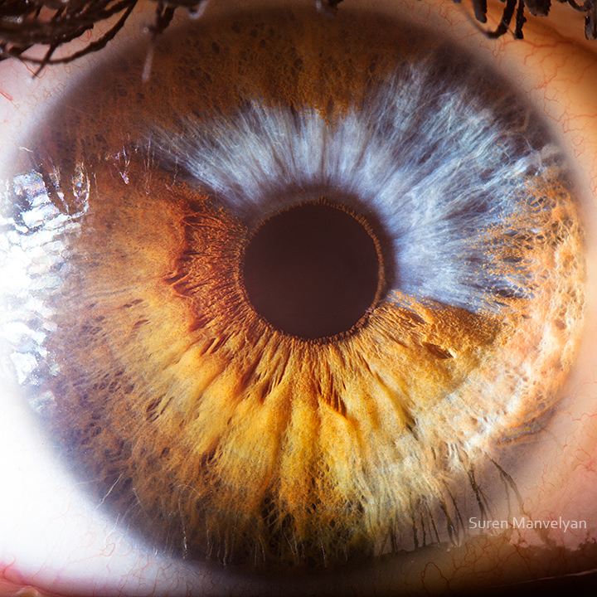
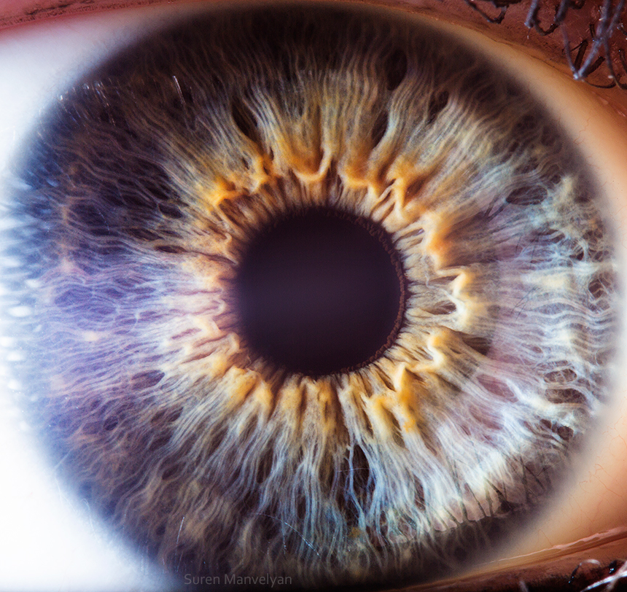

Slide 21
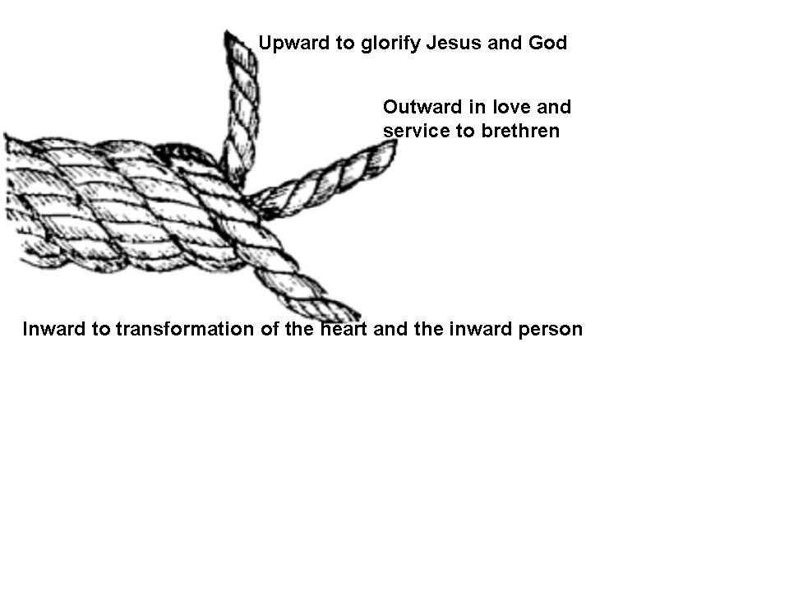









Slide 22




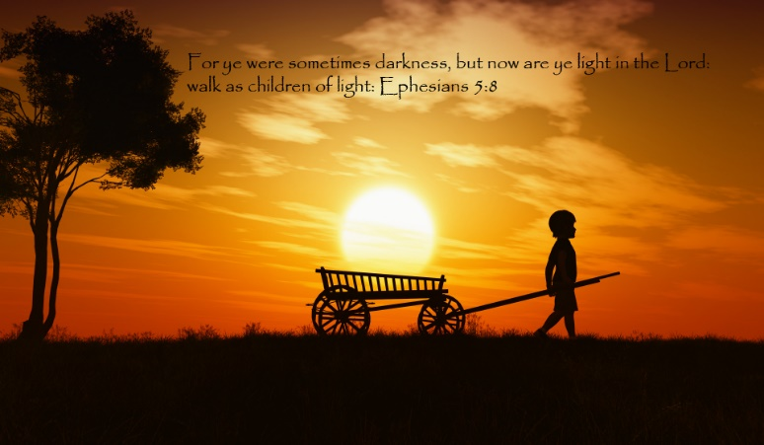



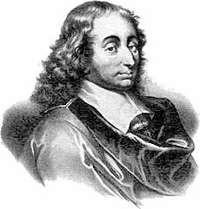
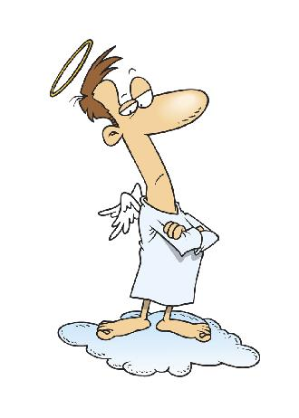

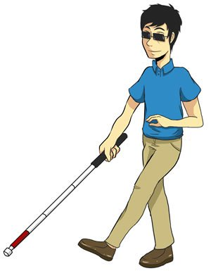
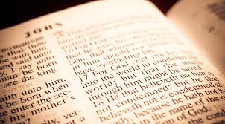
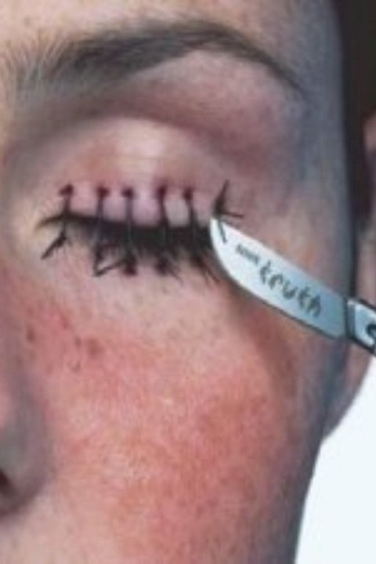
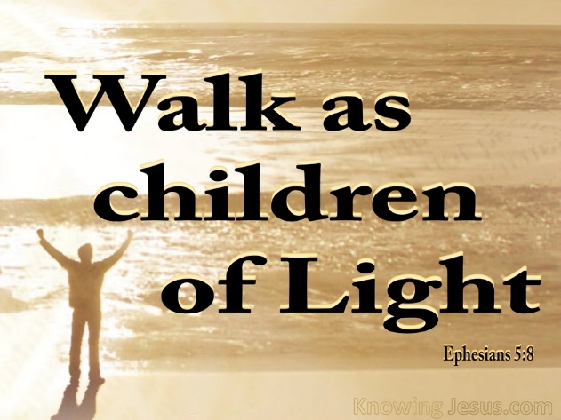
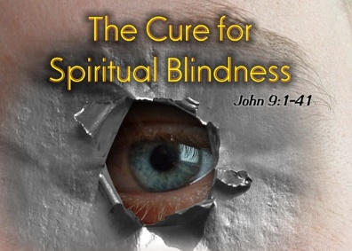

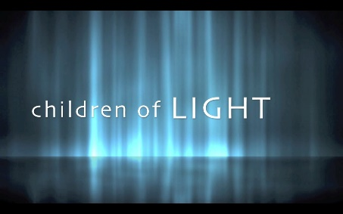

Slide 23
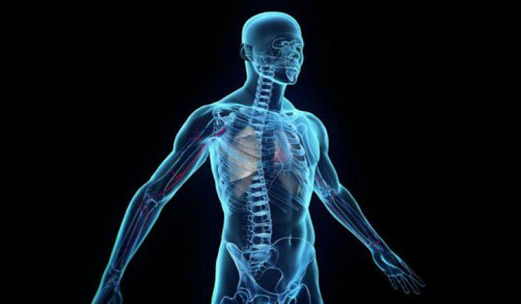



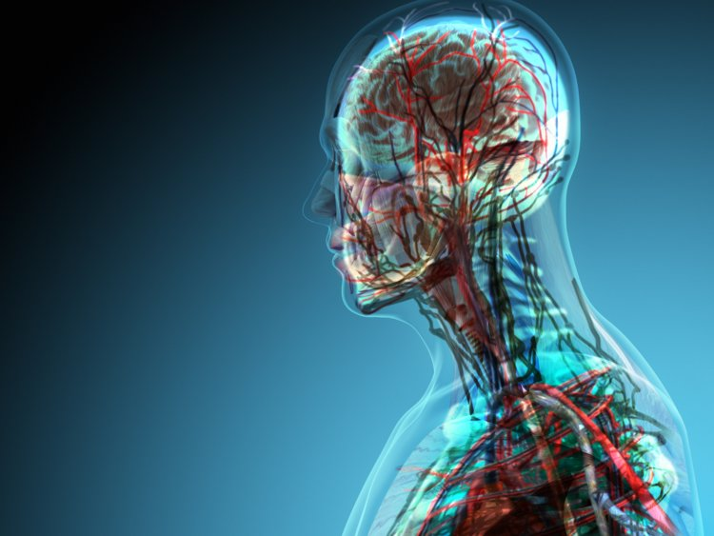


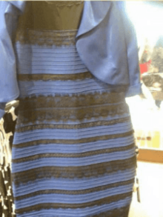

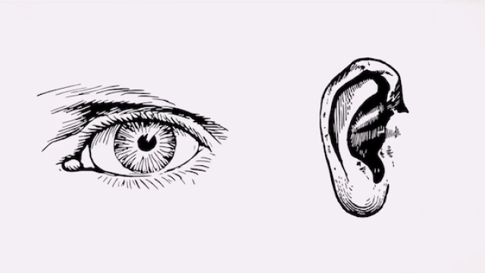









Slide 24
















Slide 25















Slide 26












Slide 27


Slide 28












Slide 29






Slide 30

















Slide 31







Slide 32


















Slide 33



